Slide 1
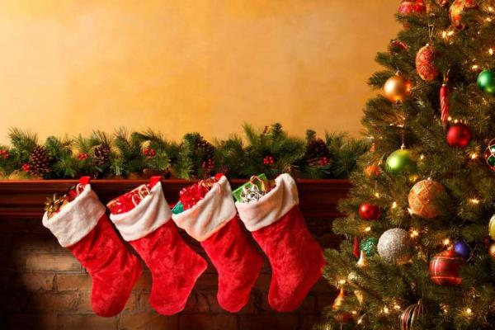

Special occasions
Christmas
Holidays and Celebrations
Basic 3 Lesson A
Mother´s Day

Slide 2
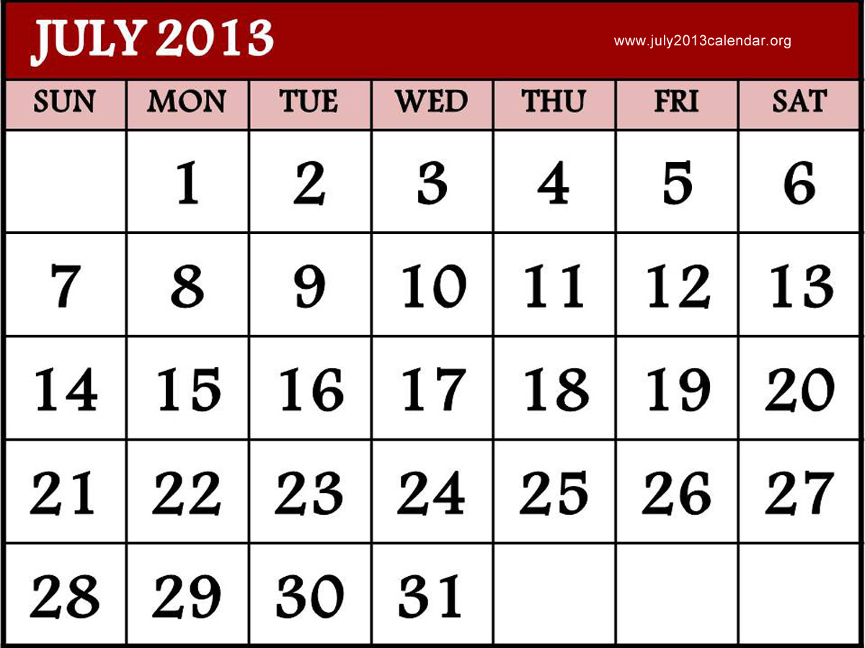

Slide 3
To express order use Ordinal Numbers :

Slide 4
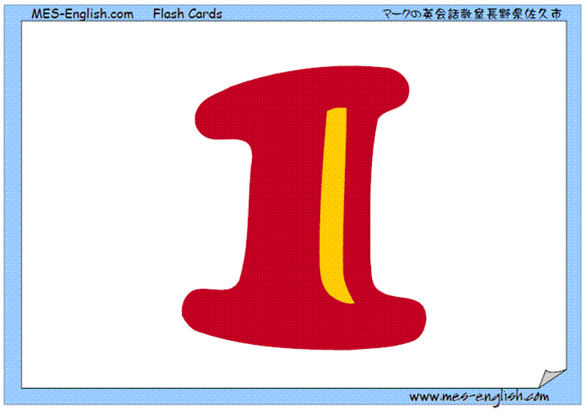
st
First

Slide 5
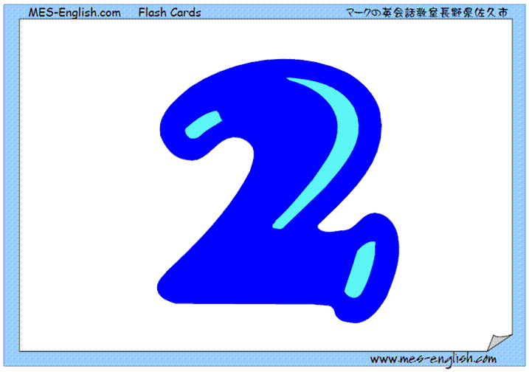
nd
Sencond

Slide 6
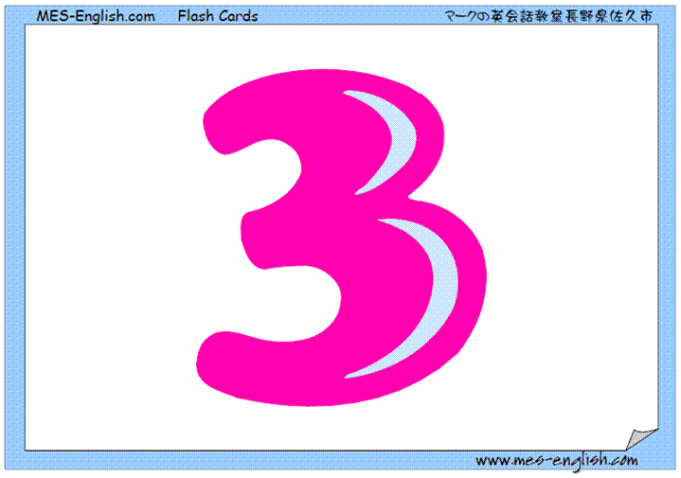
rd
Third

Slide 7
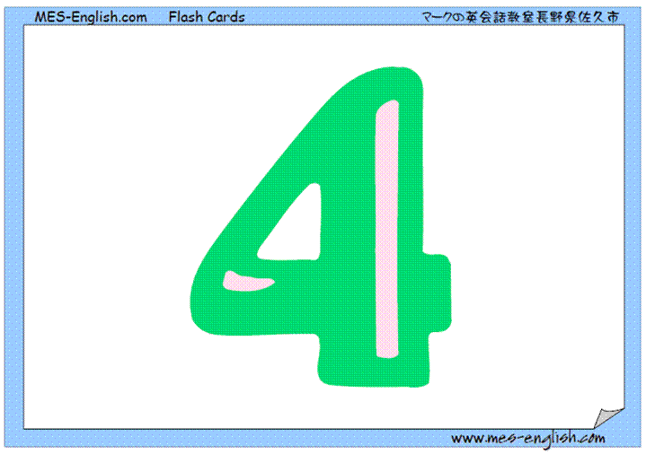
th
Fourth

Slide 8
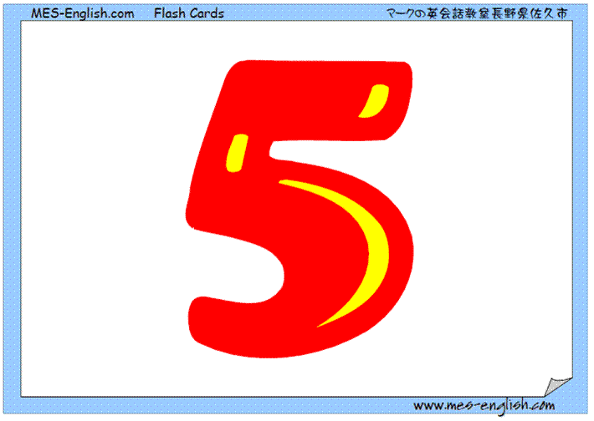
th
Fifth

Slide 9
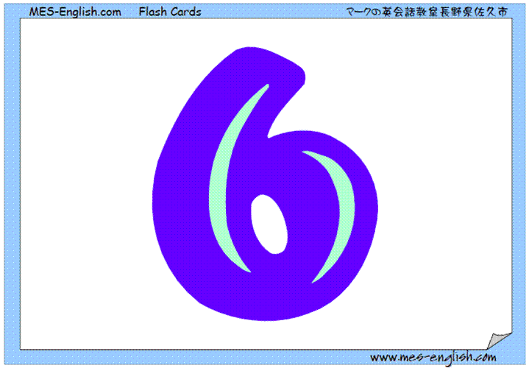
th
Sixth

Slide 10
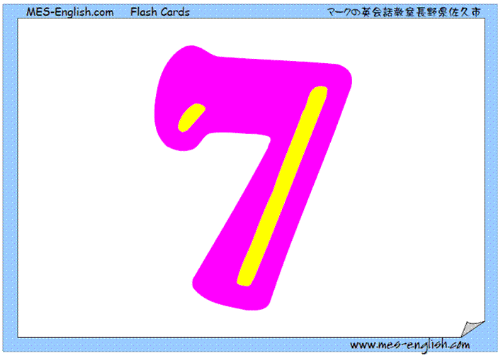
th
Seventh

Slide 11
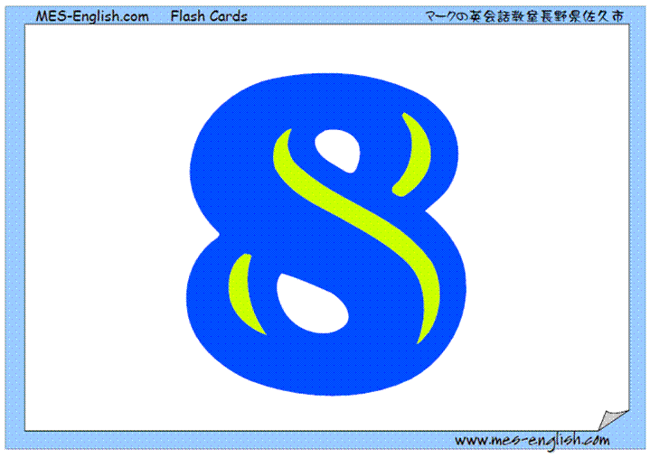
th
Eighth

Slide 12
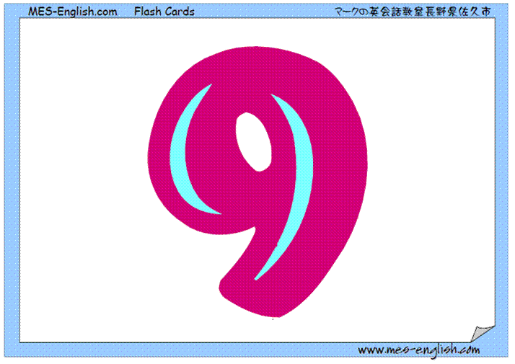
th
Ninth

Slide 13
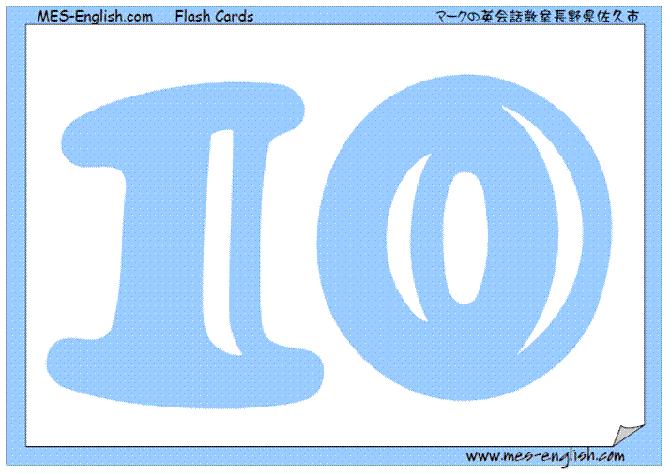
th
Tenth

Slide 14
th
Eleventh

Slide 15
th
twelfth

Slide 16
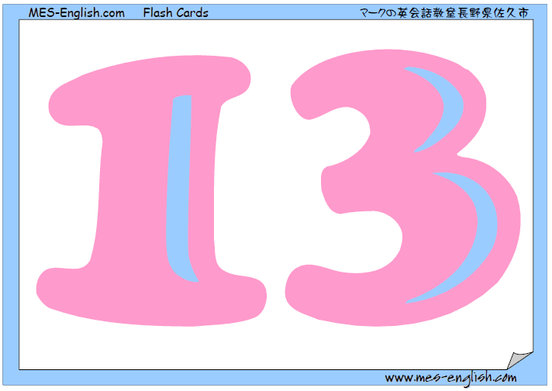
th
thirteenth

Slide 17
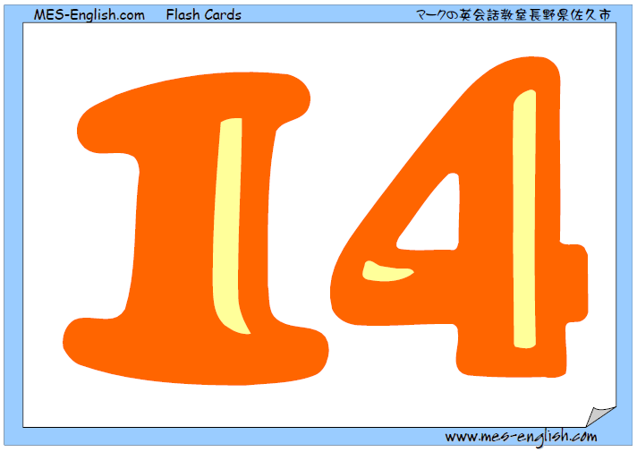
th
fourteenth

Slide 18
th
fifteenth

Slide 19
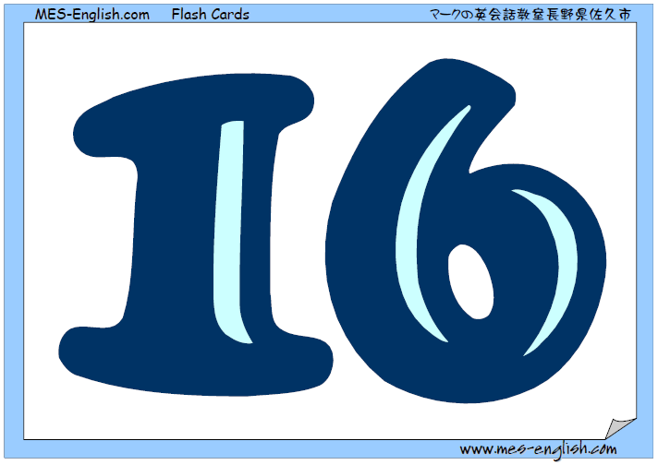
th
sixteenth

Slide 20
th
seventeenth

Slide 21
th
eighteenth

Slide 22
th
nineteenth

Slide 23
th
twentieth

Slide 24
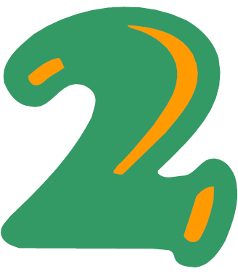
st
Twenty-first

Slide 25
nd
Twenty-second

Slide 26
rd
Twenty-third

Slide 27
th
Twenty-fourth

Slide 28
th
Twenty-fifth

Slide 29
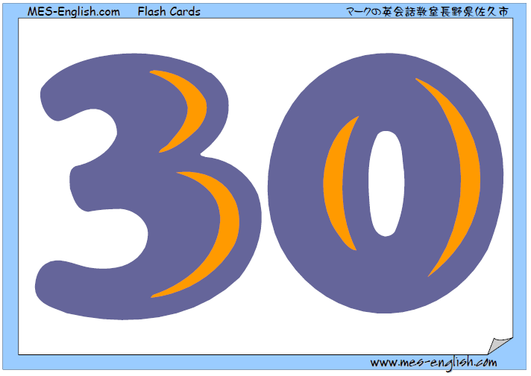
th
thirtieth

Slide 30
th
fortieth

Slide 31
th
fiftieth

Slide 32
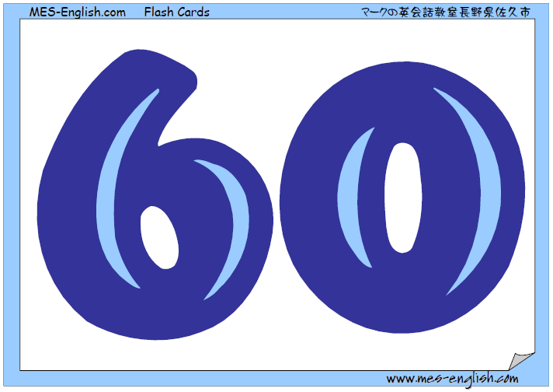
th
sixtieth

Slide 33
th
seventieth

Slide 34
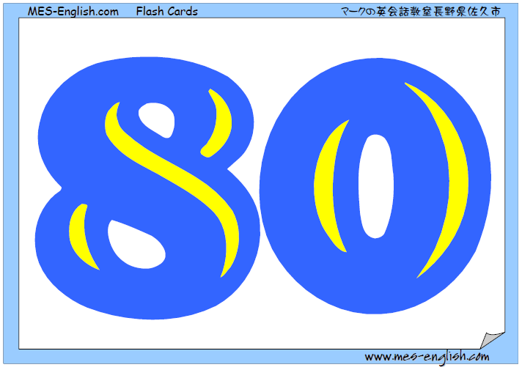
eightieth

Slide 35
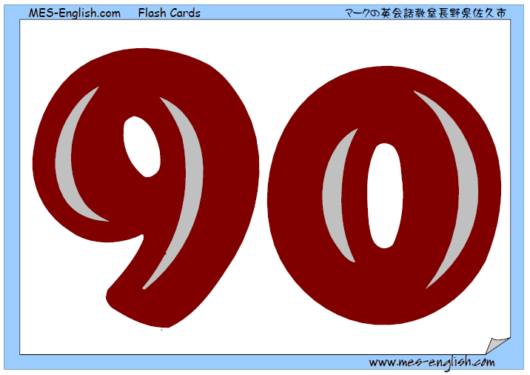
th
ninetieth

Slide 36
th
one hundredth

Slide 37
5-1 USING IT TO TALK ABOUT TIME
QUESTION
ANSWER
(a) What day is it?
(b) What month is it?
(c) What year is it?
(d) What’s the date today?
It’s Friday.
It’s October.
It’s 2015.
It’s June 8.
It’s June 8^{th.}

Slide 38
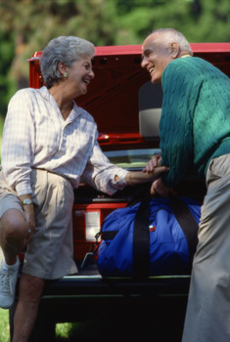
5-1 Let’s Practice
It’s Wednesday.
_______________?
What day
is it
Sunday
Monday
Tuesday
Wednesday
Thursday
Friday
Saturday

Slide 39
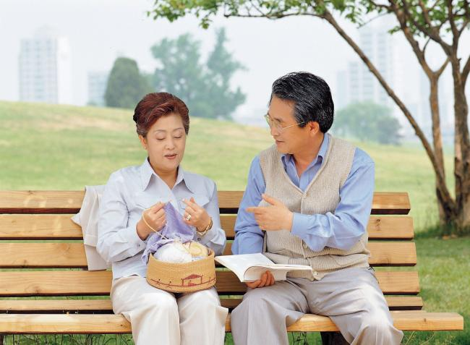
5-1 Let’s Practice
What’s the date today
___________________?
The 3rd of May, 2012.
May 2012
Sun | Mon | Tue | Wed | Thu | Fri | Sat
 |  |  |  | 1 | 2 | 3
4 | 5 | 6 | 7 | 8 | 9 | 10
11 | 12 | 13 | 14 | 15 | 16 | 17
18 | 19 | 20 | 21 | 22 | 23 | 24
25 | 26 | 27 | 28 | 29 | 30 | 31

Slide 40

Copyright © 2005 – 2006 MES-English.com

Slide 41
Copyright © 2009 MES-English.com

Slide 42
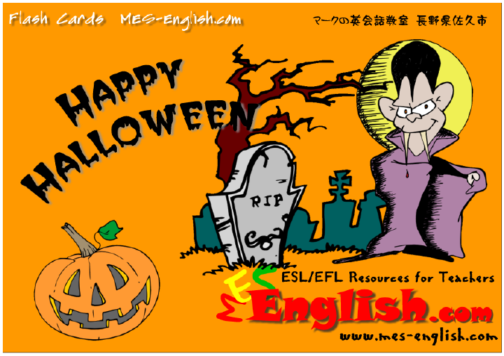
Copyright © 2005 – 2006 MES-English.com

Slide 43
Copyright © 2009 MES-English.com

Slide 44
Are the holidays in B celebrated in Peru? Are they on the same day?
Yes, they are. New years´s eve is celebrated on the same/a different day. It is celebrated on ___. Labor Day is celebrated on the same/a different day. It………
Name two other important holidays in Peru. When are they?
Two important holidays in Peru are_X_ and _Y_. _X_ is celebrated on_date_. And _Y_ is celebrated on __date__
What is your favorite holiday? When is it? Why do you like it?
My favorite holiday is _x_. It is on __date__. I like it because ________

